Slide 1
Analysis on Cricket(IPL) Dataset
- Akshay Ankush Kapare
CS 779 Project PPT

Slide 2
Introduction
The Indian Premier League (IPL) is a professional Twenty20 cricket league in India usually contested between March and May of every year by thirteen teams representing thirteen different cities or states in India.
In this project I have taken data for every bowl bowled in match played between year 2008 to 2017. I have done analysis on Total Runs, total wickets taken, Winning team etc.
I also created a Functions to get Match info by Match ID and Season info by year
I have also performed weather analysis on match played in Delhi from 2013 to 2016.

Slide 3
Dataset
IPL Dataset
IPL dataset contain total 6 csv files having data Ball id , run scored , wicket taken or not on the ball, player info, match info , Team names , Information about which player played in which match , Winning teams by season.
Data source : https://www.kaggle.com/raghu07/ipl-data-till-2017?select=Match.csv
Weather Dataset
Weather Dataset has data about everyday Mean Temperature , Humidity, Wind speed , Pressure Of Delhi city from 2013 to 2017.
Data source : https://www.kaggle.com/sumanthvrao/daily-climate-time-series-data

Slide 4
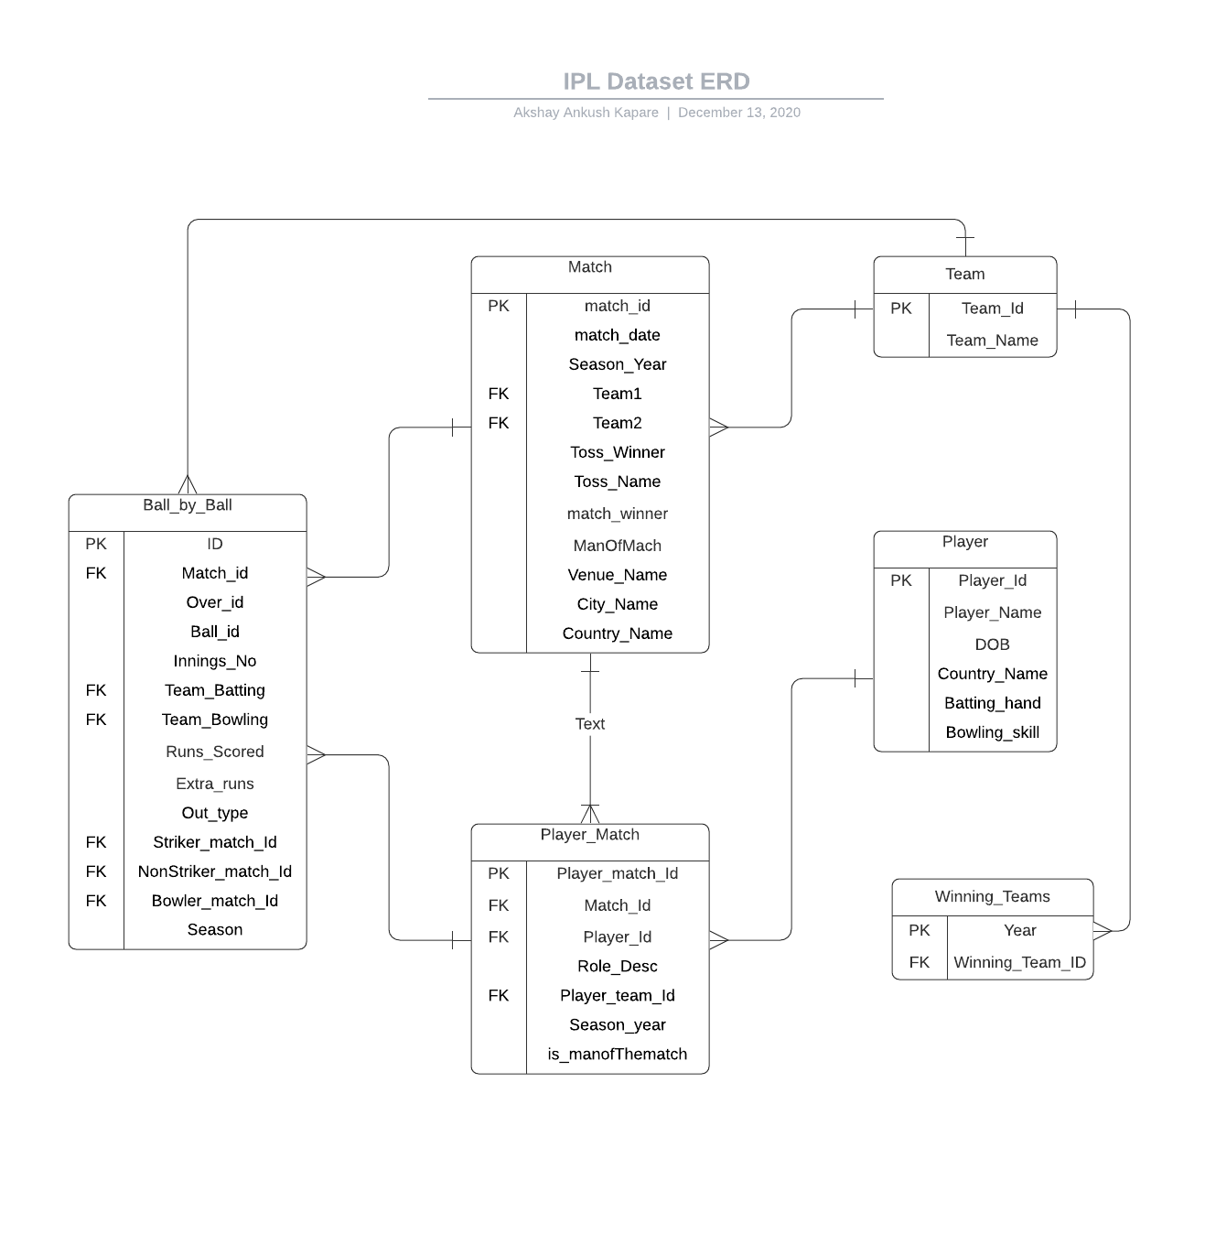
ERD

Slide 5
Data Preprocessing
My all data was in CSV format I used Python language to prepossess my data and removed unwanted columns and rows
Using Pandas function I stored all the data in Data frame and then according to PK and FK I have map the data of all the data frames with each other
Following Library used to preprocess the data:
Pandas
Datetime
After that I have create table in SQL server where I need to add the all the data from data frame(We can perform this using python script also)
After Preprocessing the data, I used pyodbc library in python to connect my SQL server with juputer notebook and added all data to the SQL server

Slide 6
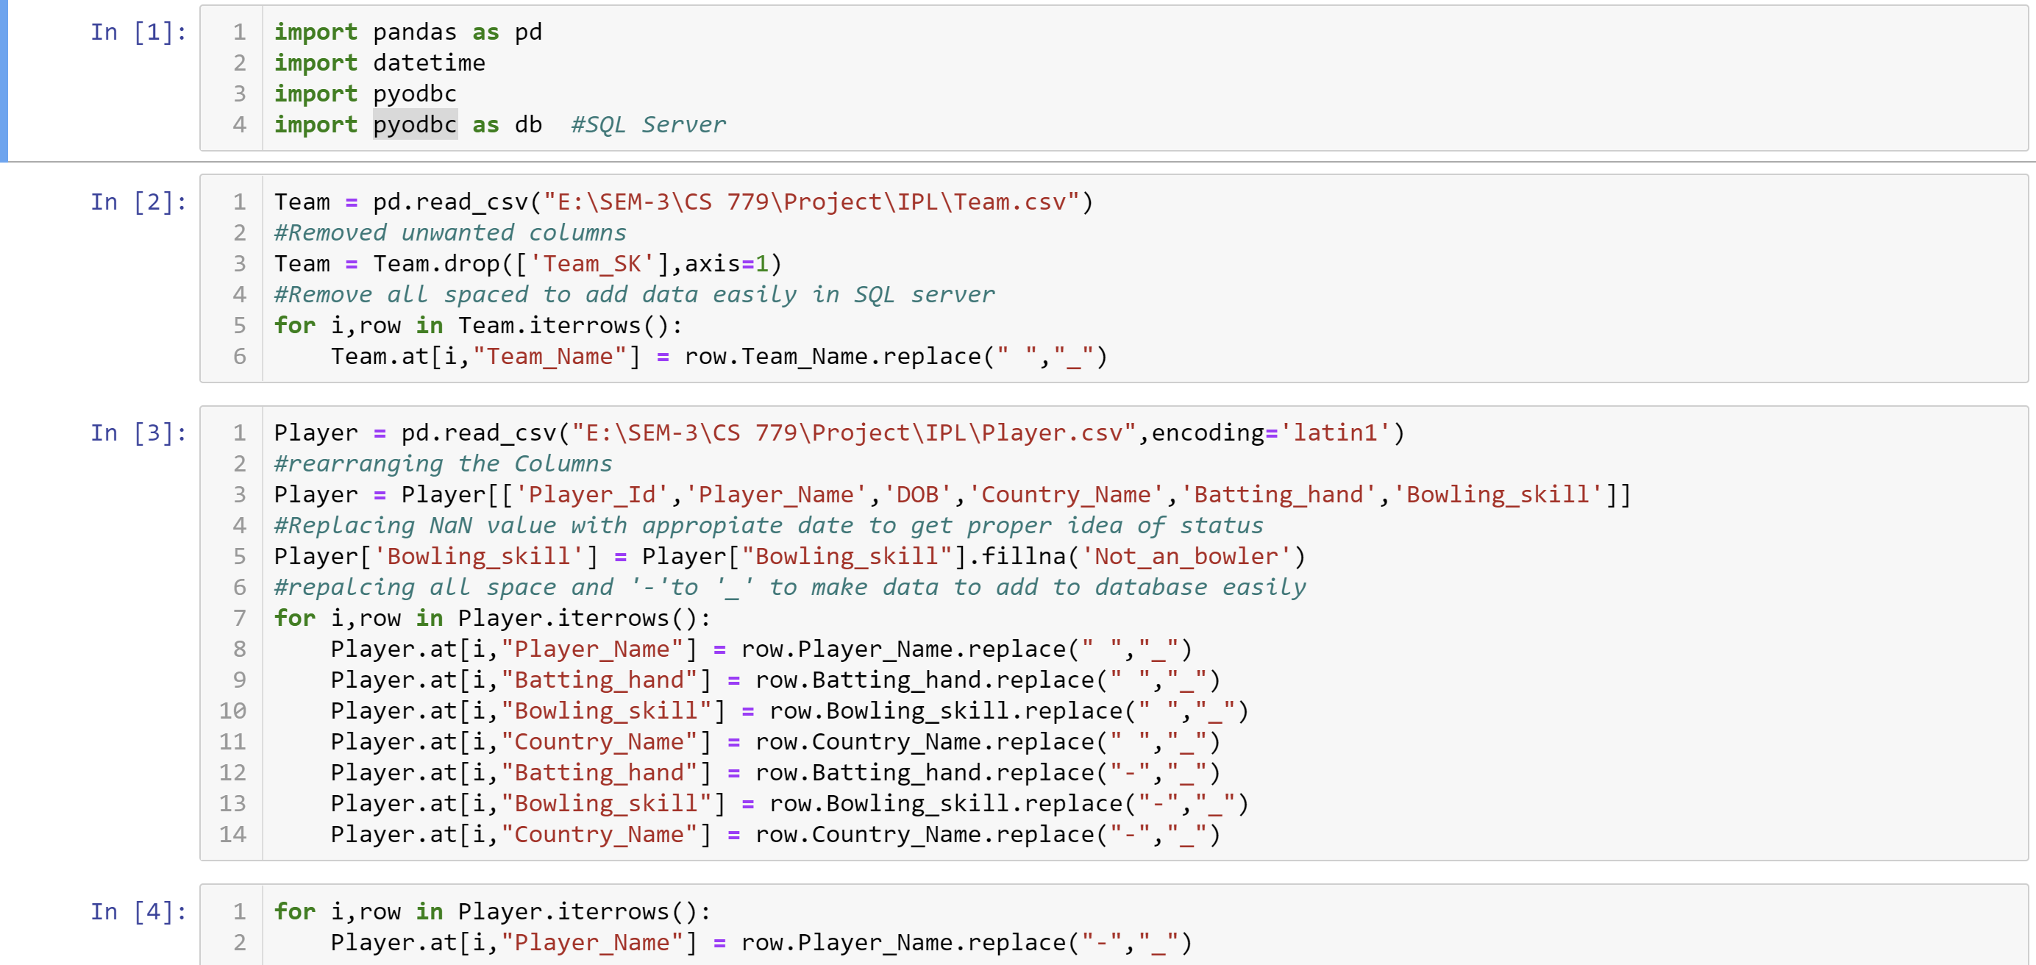
Data Preprocessing
Data Preprocessing

Slide 7
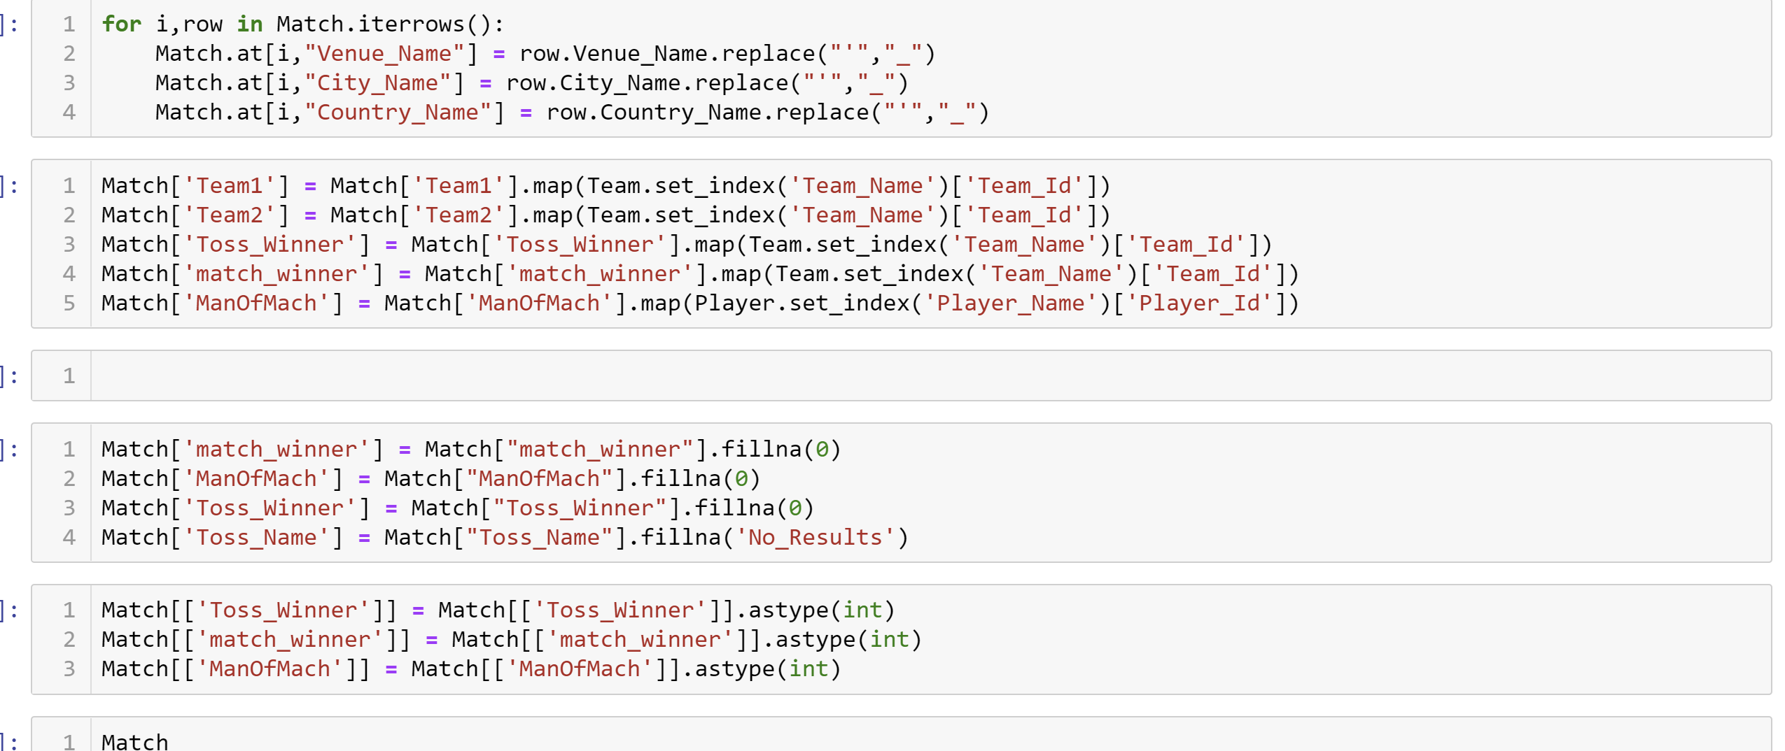
Data Preprocessing
Data Preprocessing

Slide 8
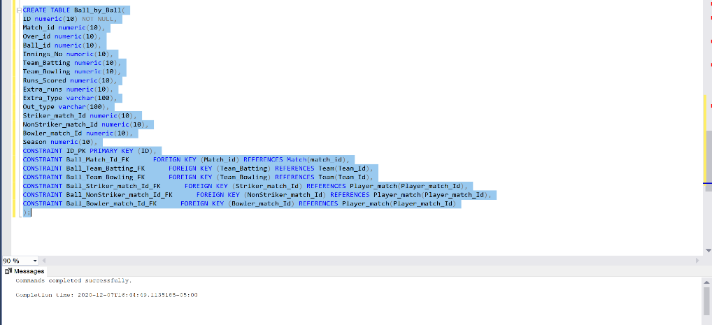
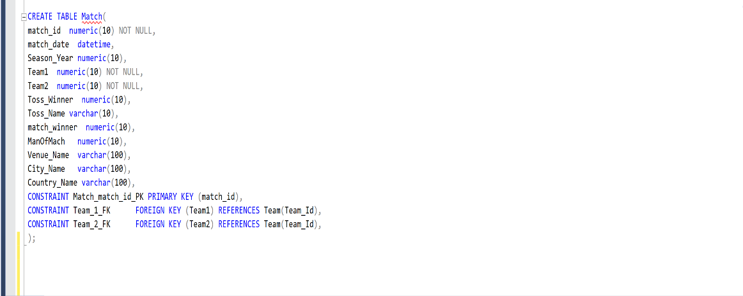
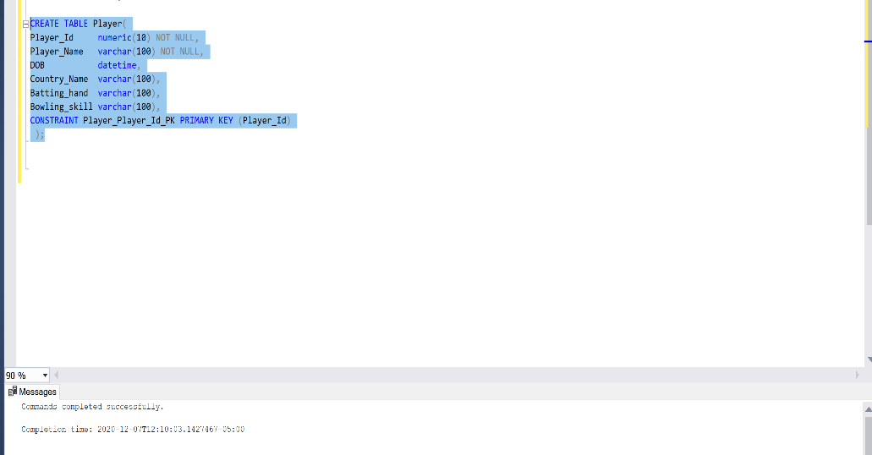
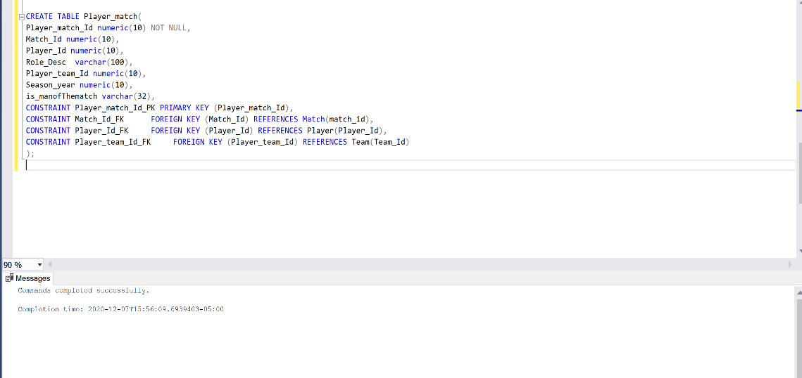
Data Preprocessing
SQL table creation

Slide 9
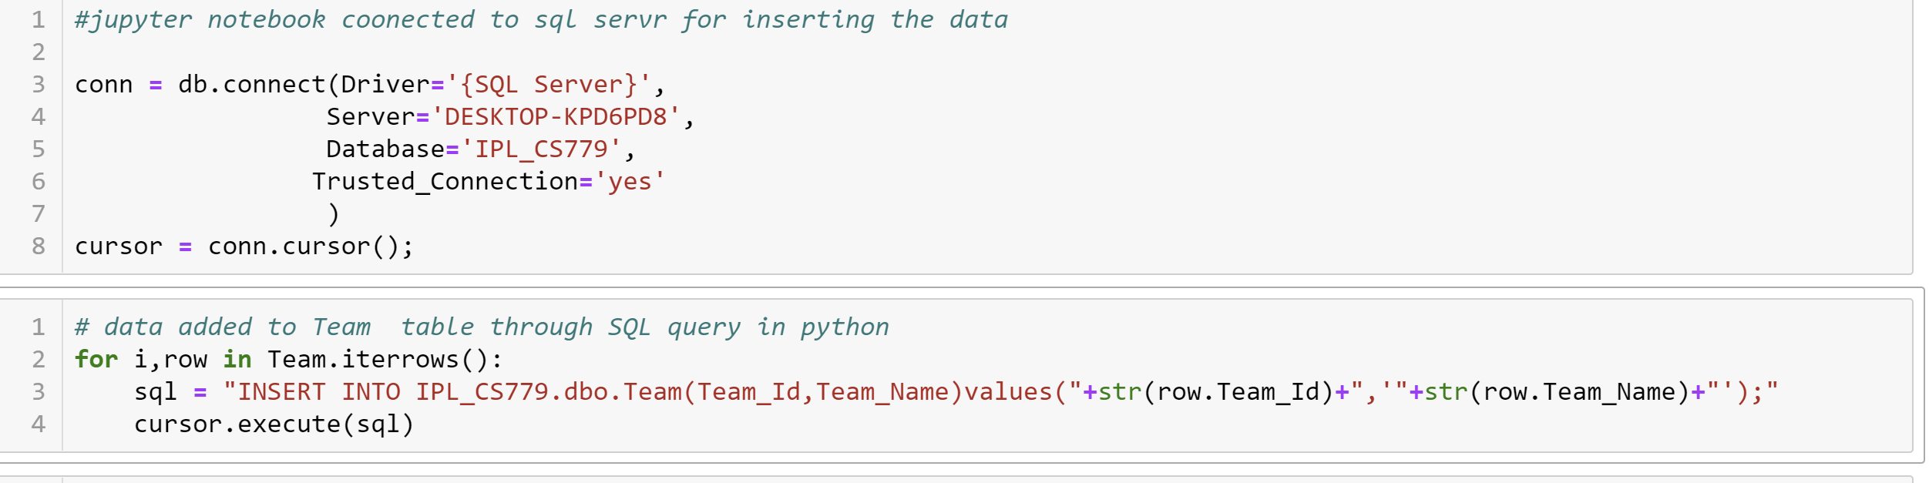
Data Preprocessing
Adding data to the sql server using python command

Slide 10
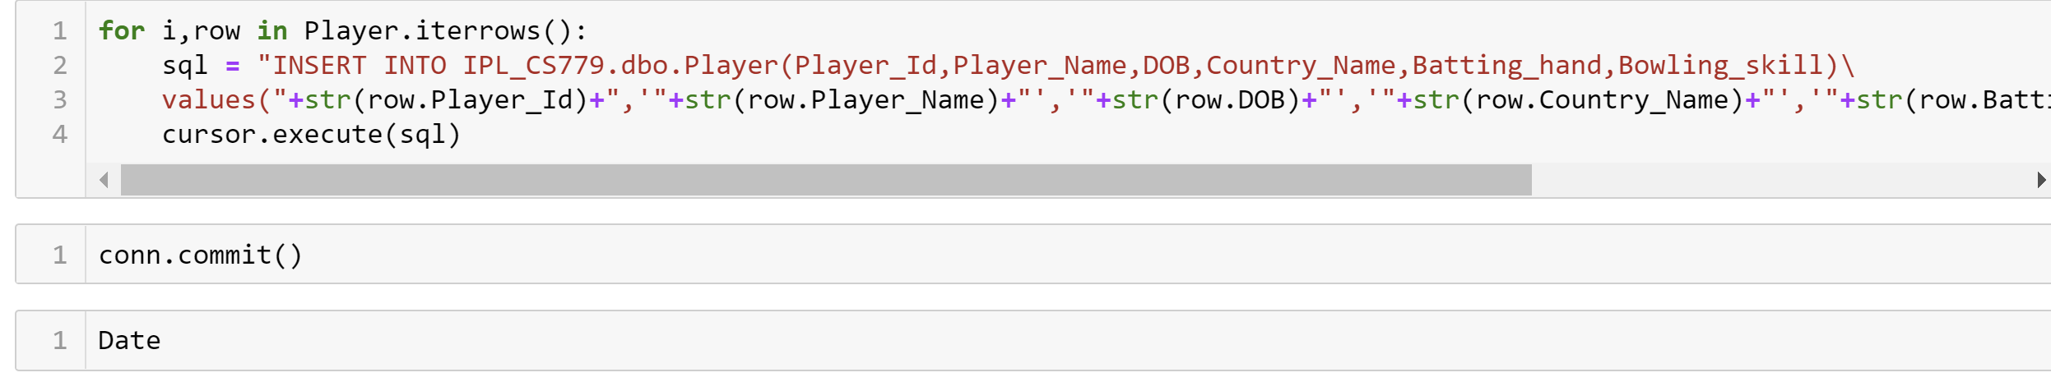
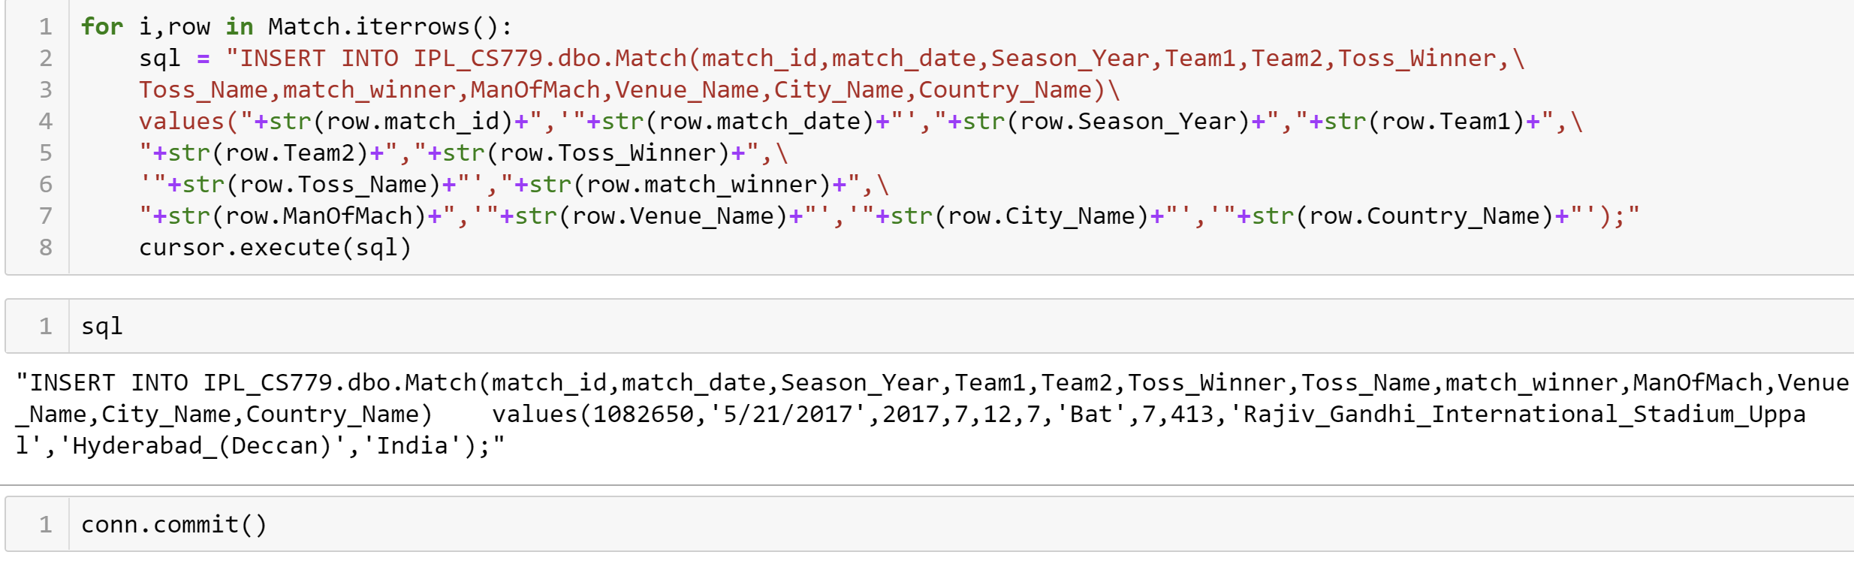
Data Preprocessing
Adding data to the sql server using python command

Slide 11
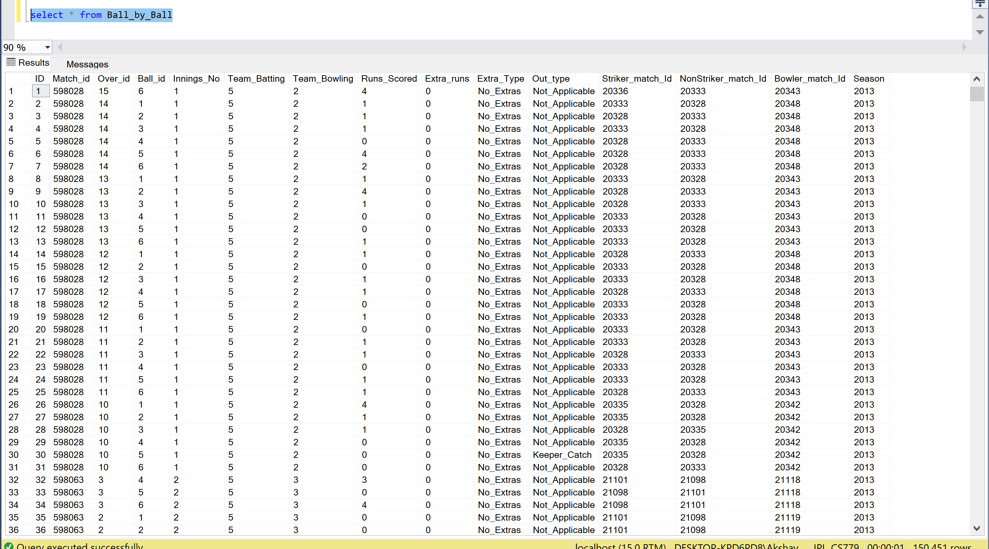
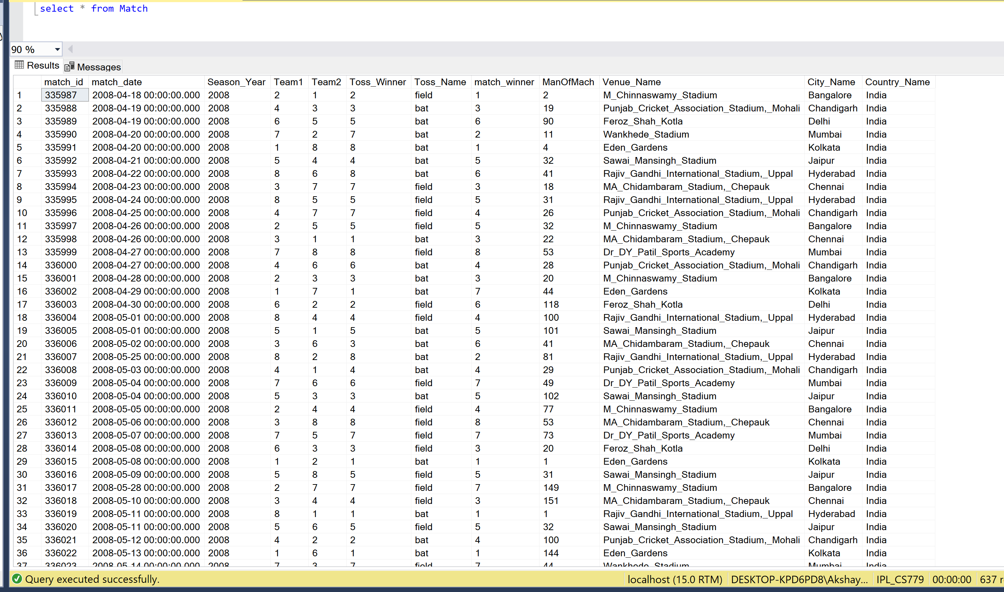
Data in SQL
Added data in SQL

Slide 12
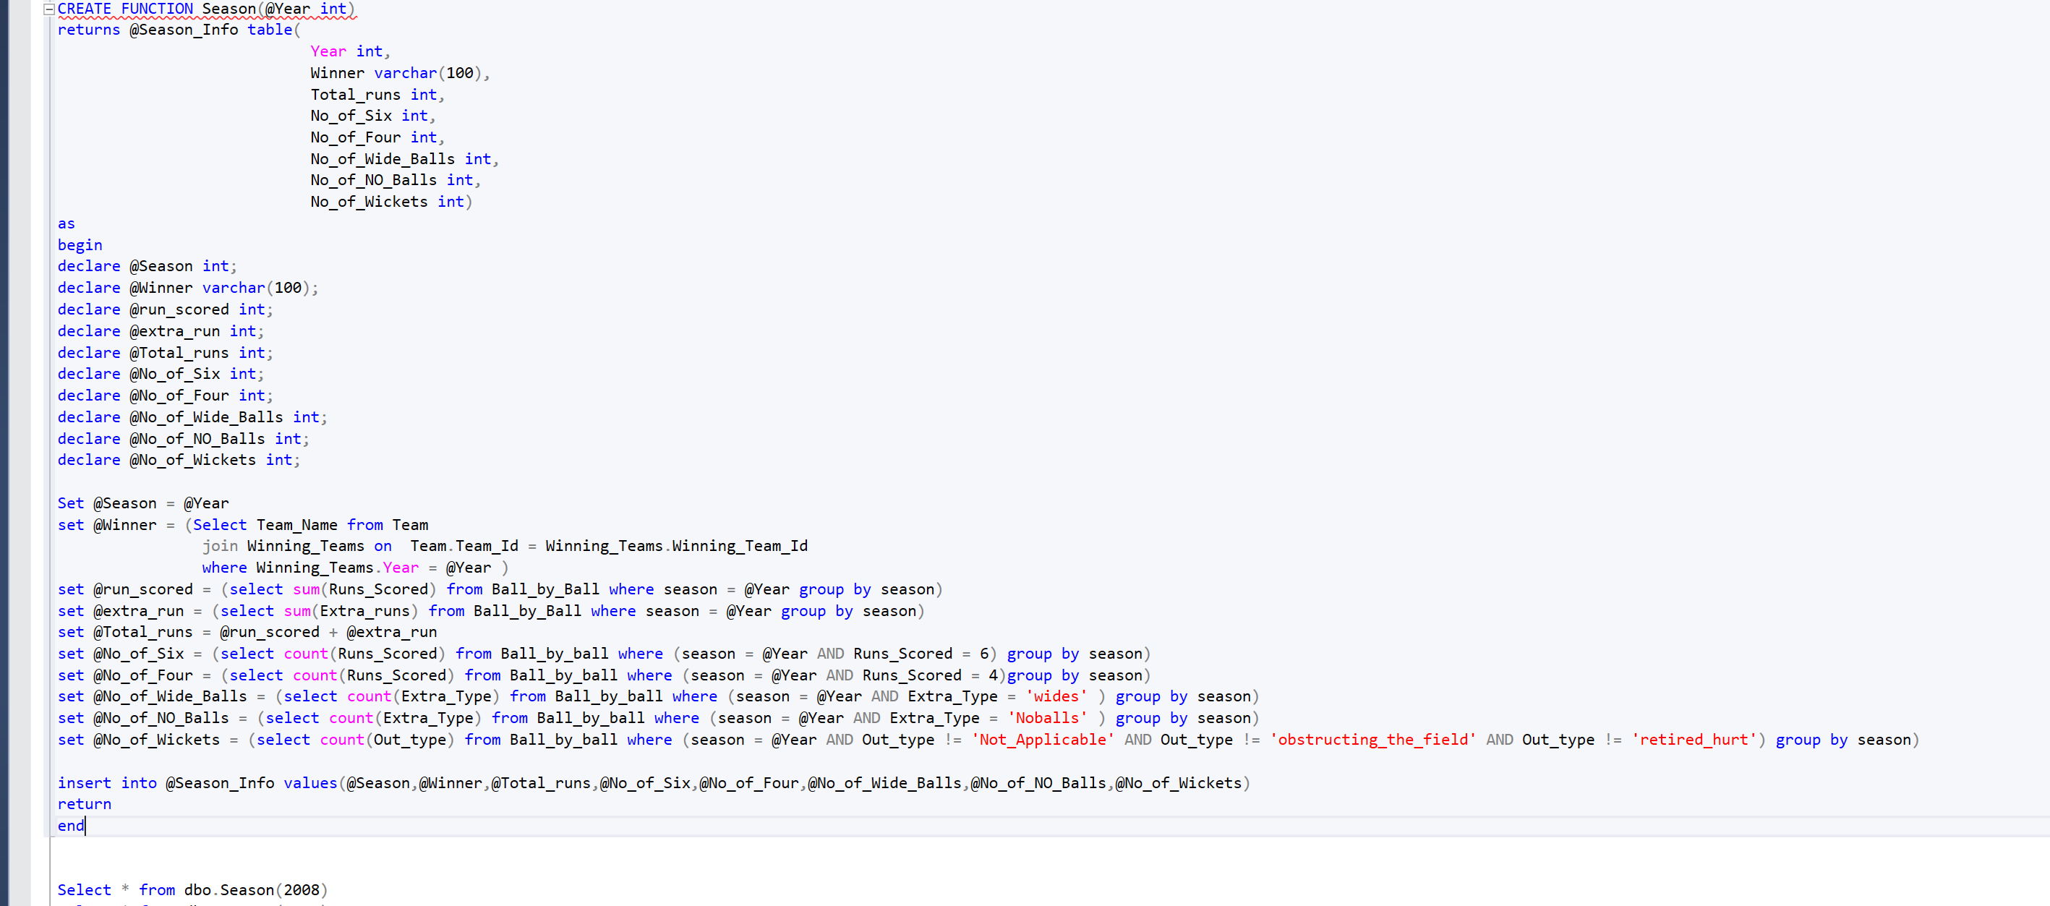
Function to find Year wise info
I have created a function which will return Year , Winner, Totala runs scored in that year , no of six , no of four , no of no balls , no of wide balls, and total wicket taken after passing year as input

Slide 13
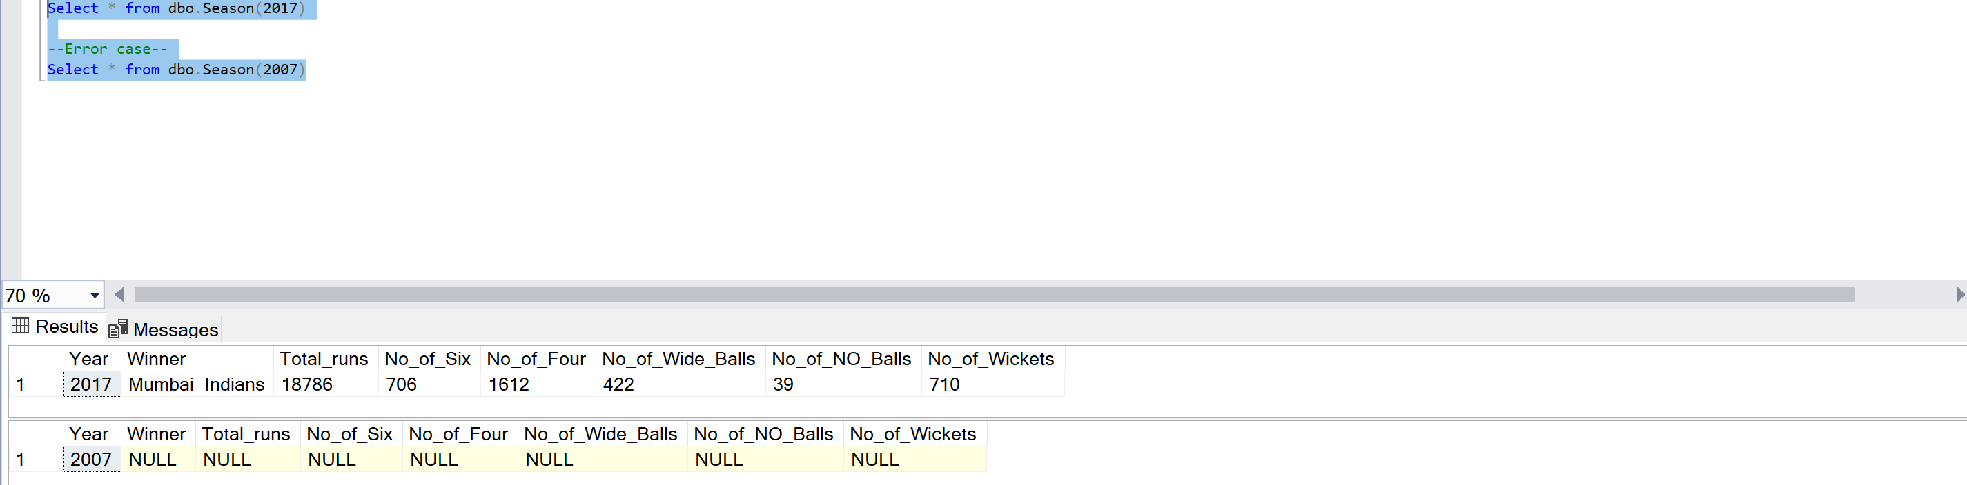
Function to find Year wise info
If we give year which is not present in data will get value as null

Slide 14
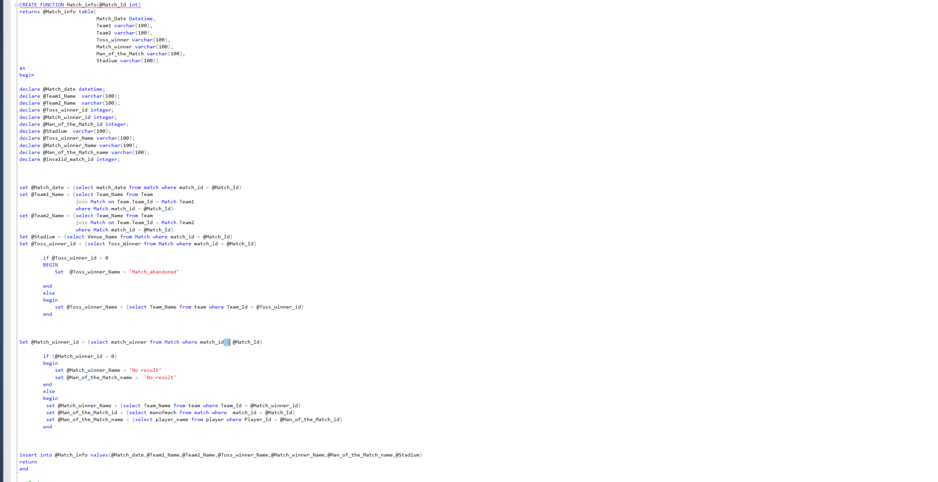
Function to find Match wise info
I have created a function which will return Match date , Team 1 , Team 2 , Toss winner , Match winner , Manof the match and stadium

Slide 15
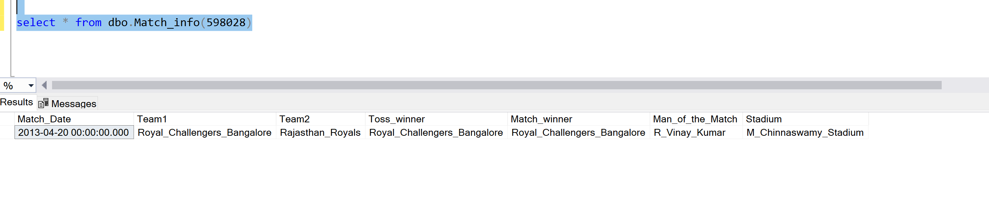
Function to find Match wise info
Output

Slide 16
Analysis on Dataset
I have used power BI to do the graphical presentation of the data
I have connected my SQL server database to Powe BI and then used all the features of the Power BI to present the data

Slide 17
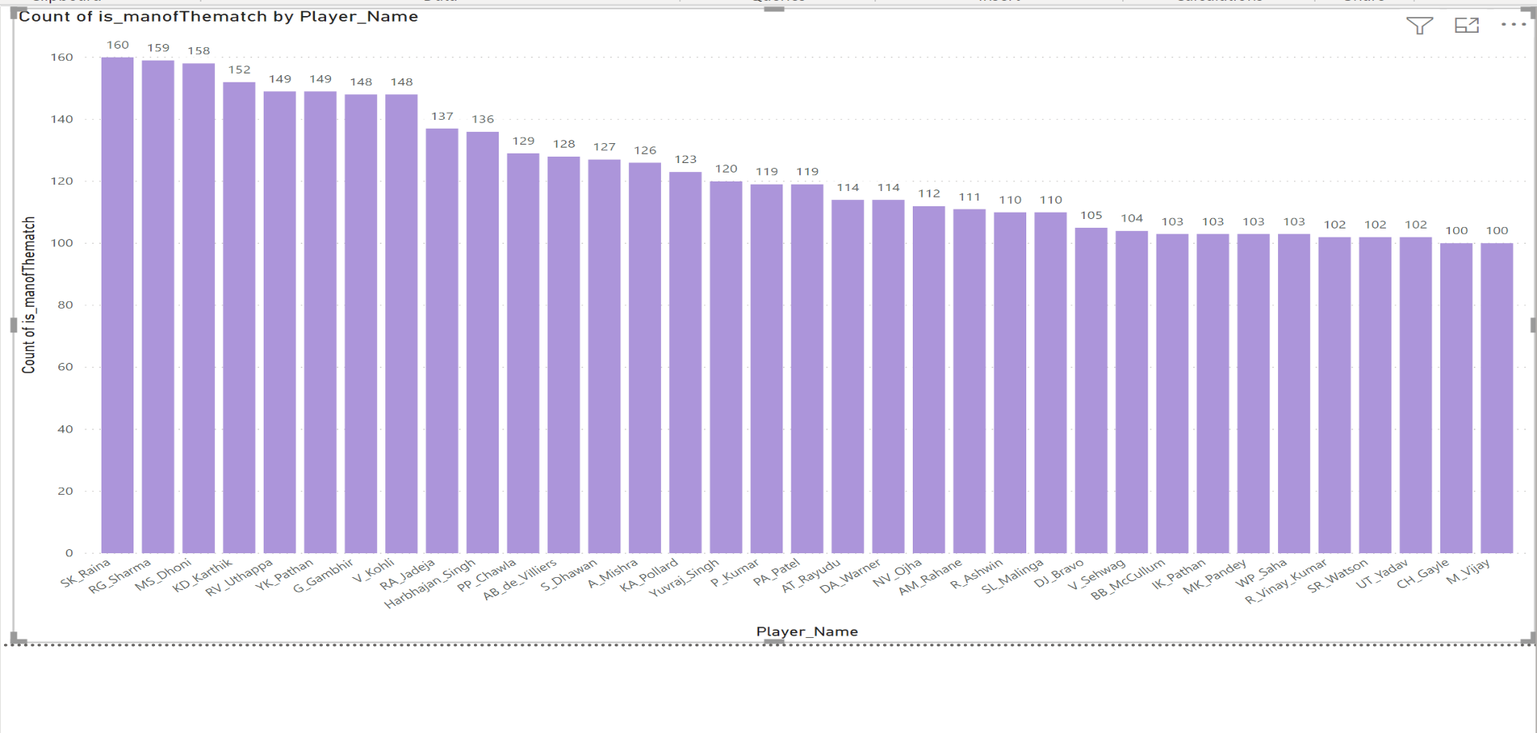
Analysis on Dataset
Count of total number of man of the match own by each player

Slide 18
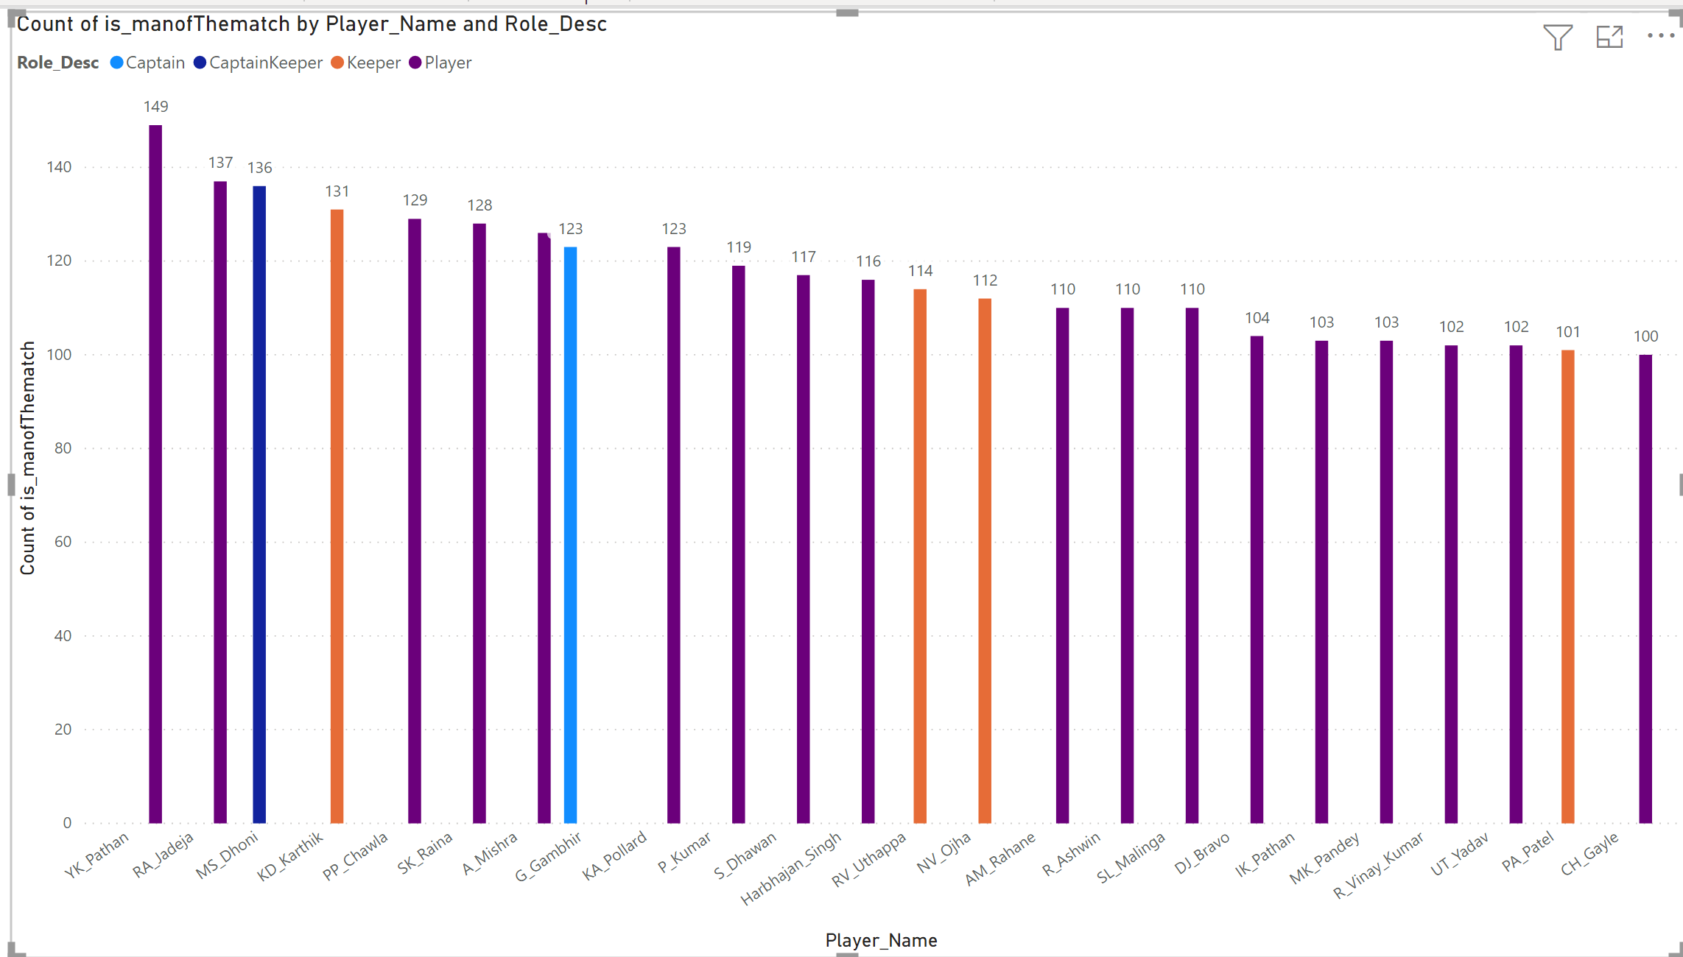
Analysis on Dataset
Count of total number of man of the match own by each player and there role in match

Slide 19
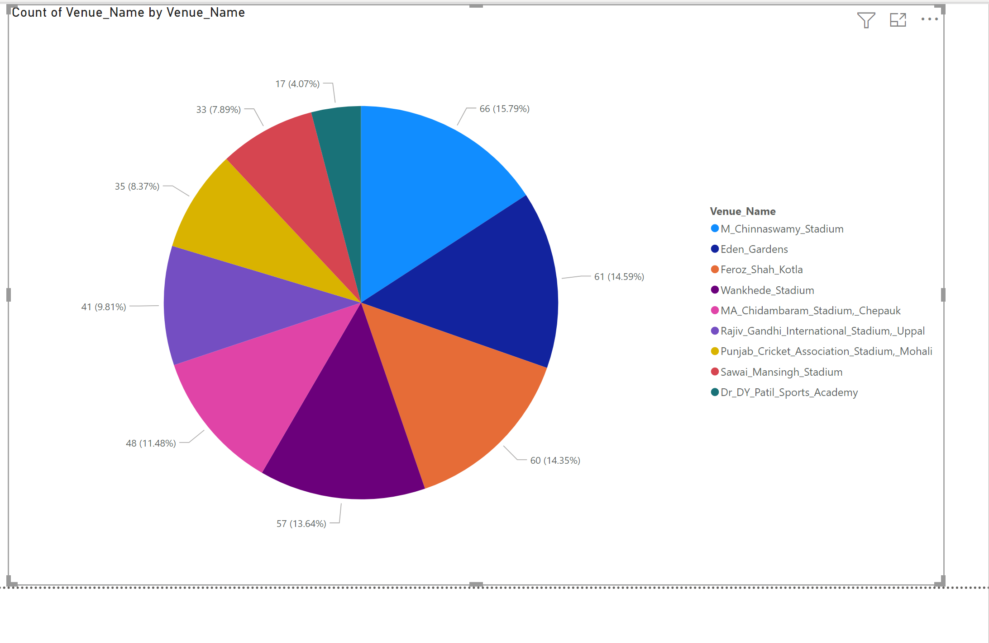
Analysis on Dataset
Pie chart of number of matches played in top stadiums

Slide 20
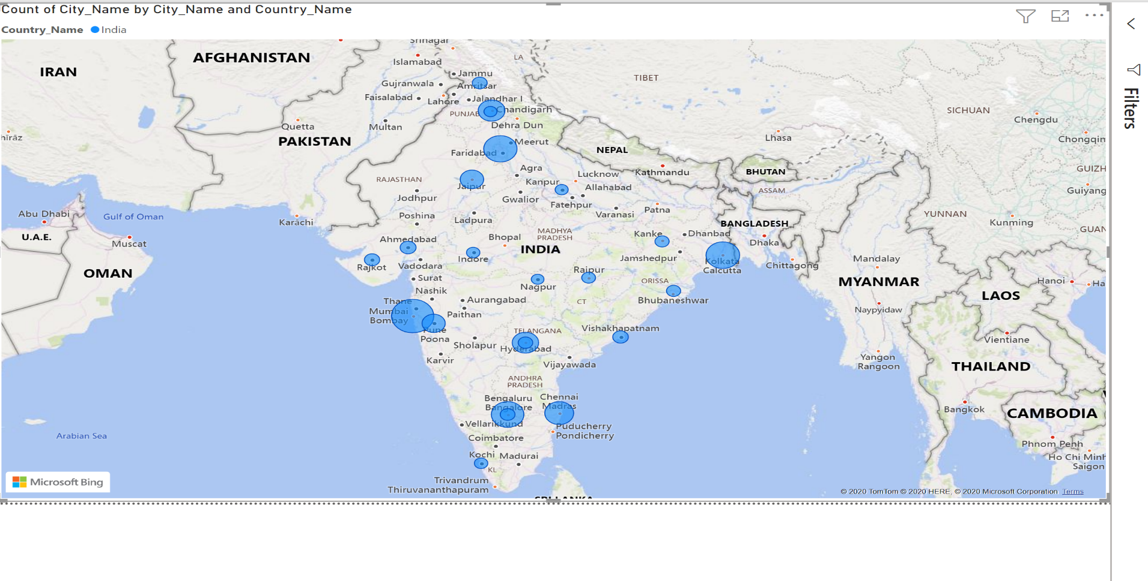
Analysis on Dataset
Map of cities in india where IPL matches are conducted

Slide 21
Weather Data Preprocessing
Weather Dataset has data about everyday Mean Temperature , Humidity, Wind speed , Pressure Of Delhi city from 2013 to 2017.
Using Pandas function I stored all the data in Data frame and then according to PK and FK I have map the data of all the data frames with each other
Following Library used to preprocess the data:
Pandas
Datetime
After that I have taken all the data from Ball-by-ball Info and mapped with my weather data set
After Preprocessing the data, I used pyodbc library in python to connect my SQL server with juputer notebook and added all data to the SQL server

Slide 22
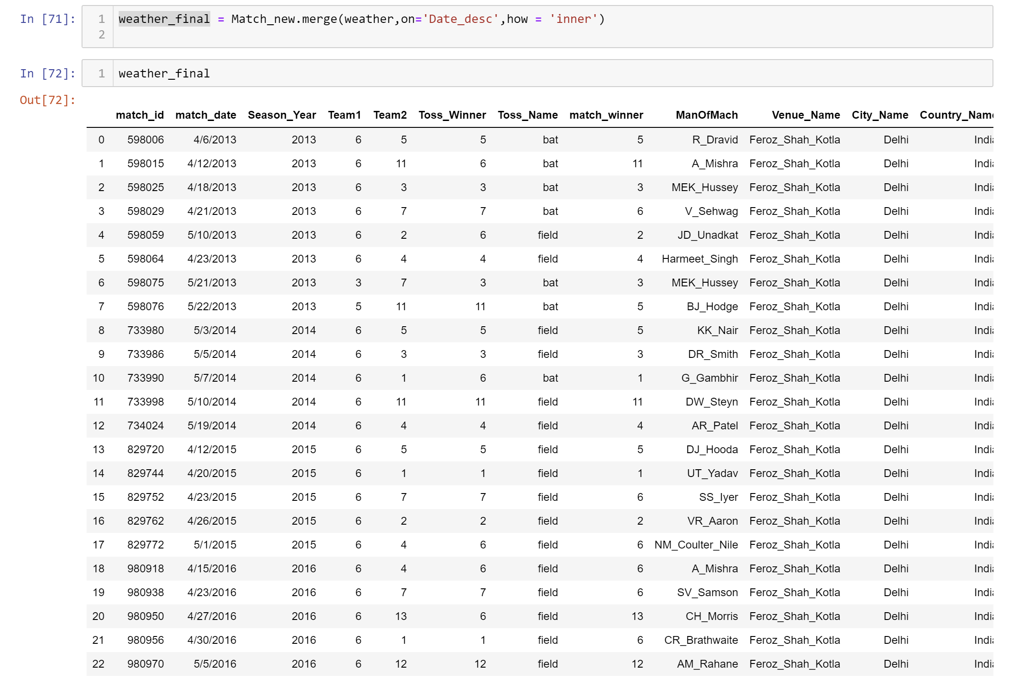
Weather Data Preprocessing

Slide 23
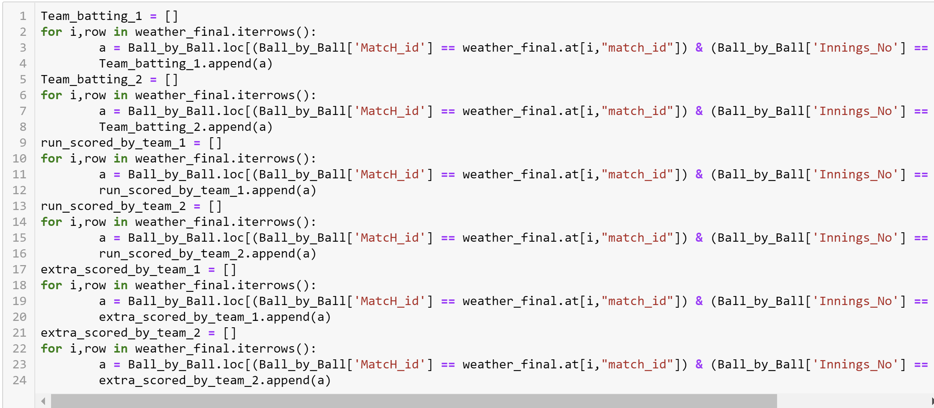
Weather Data Preprocessing

Slide 24
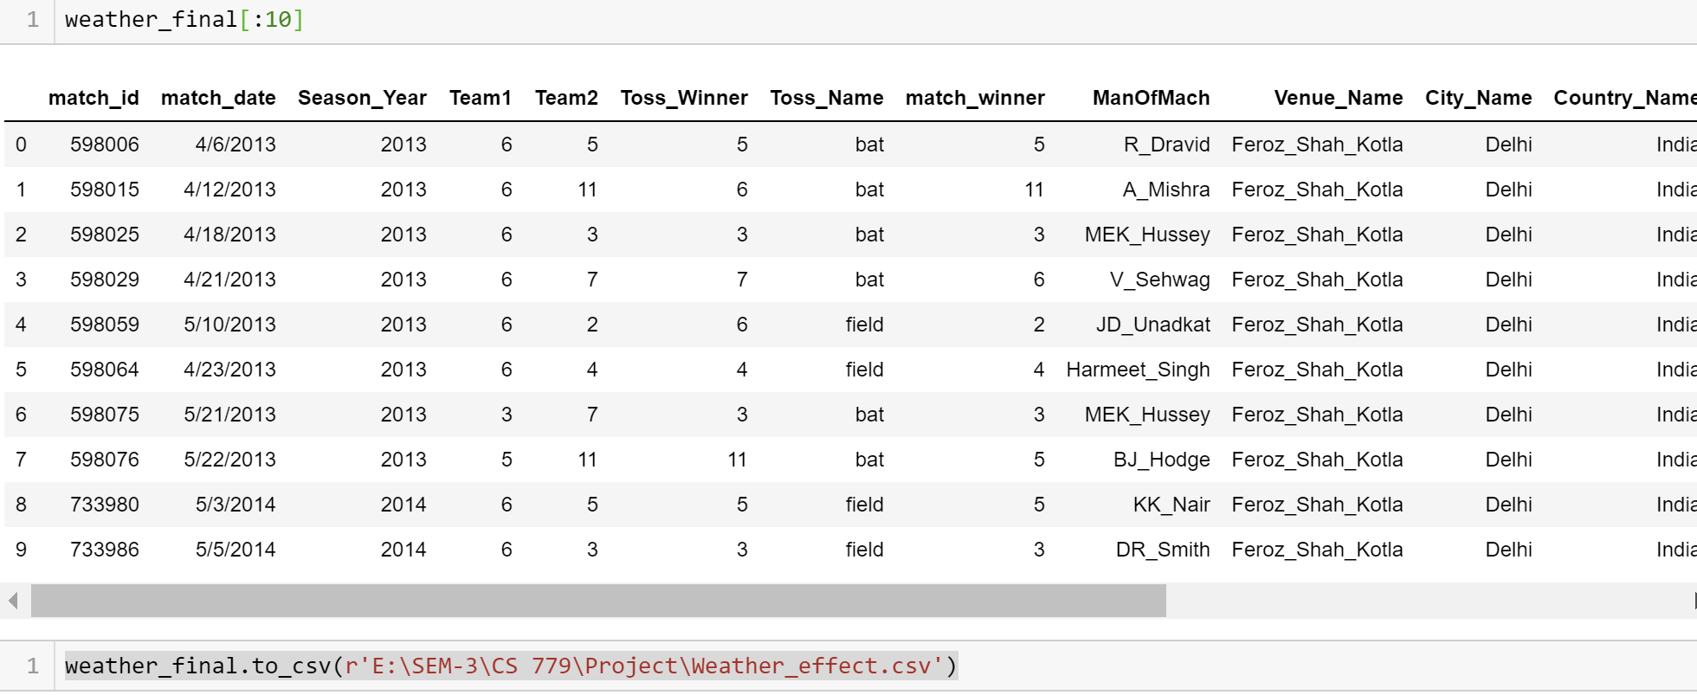
Data conversion to CSV and using it in power BI
After all the preprocessing on data I have converted data to CSV and did all the analysis on Power BI

Slide 25
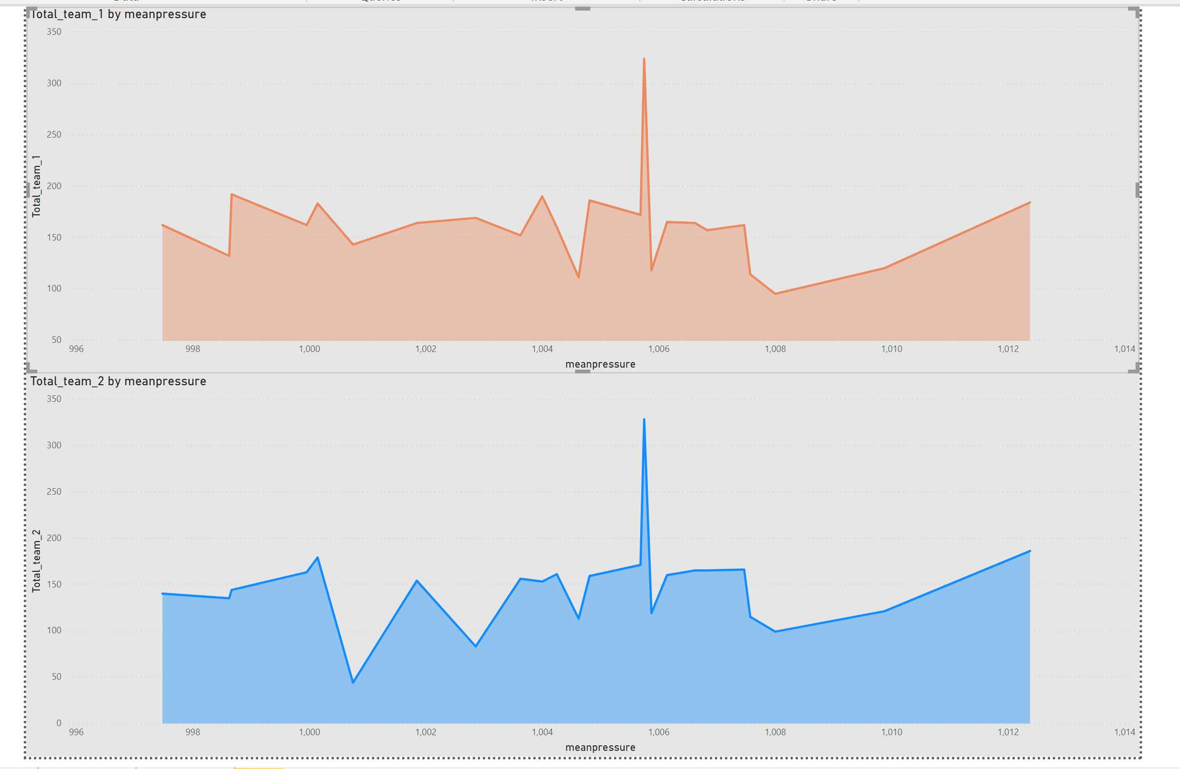
Analysis on Weather Dataset
Runs by each team VS Pressure

Slide 26
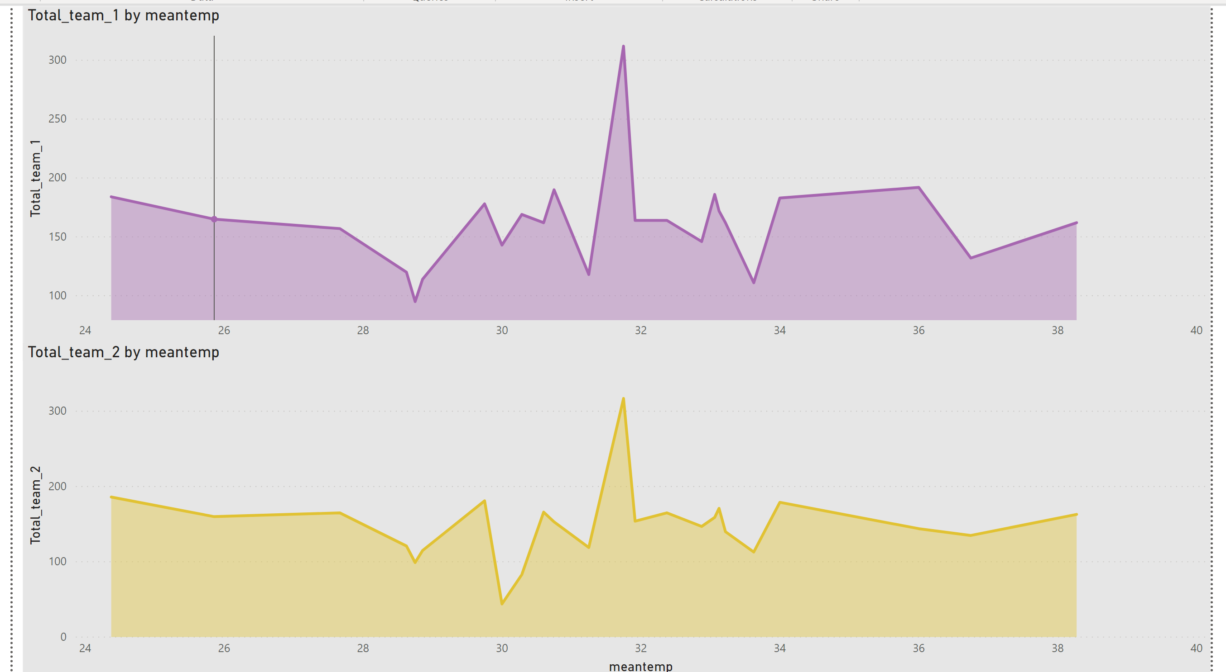
Analysis on Weather Dataset
Runs by each team VS Temp

Slide 27
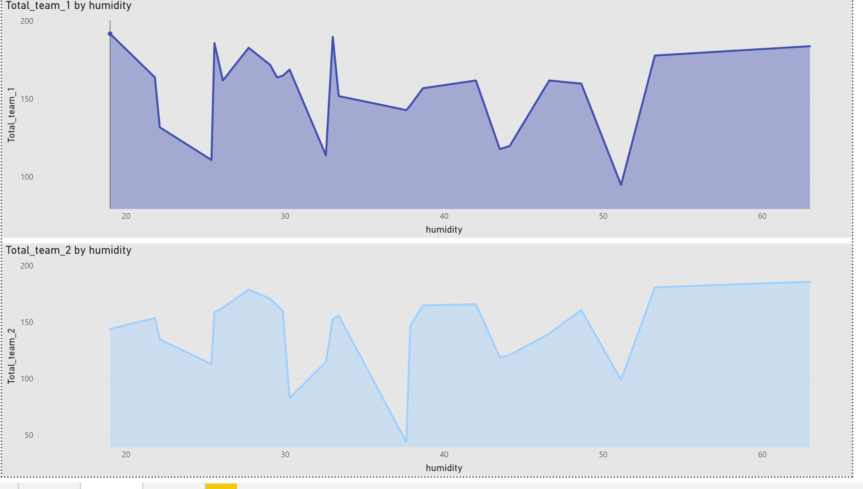
Analysis on Weather Dataset
Runs by each team VS Humidity

Slide 28
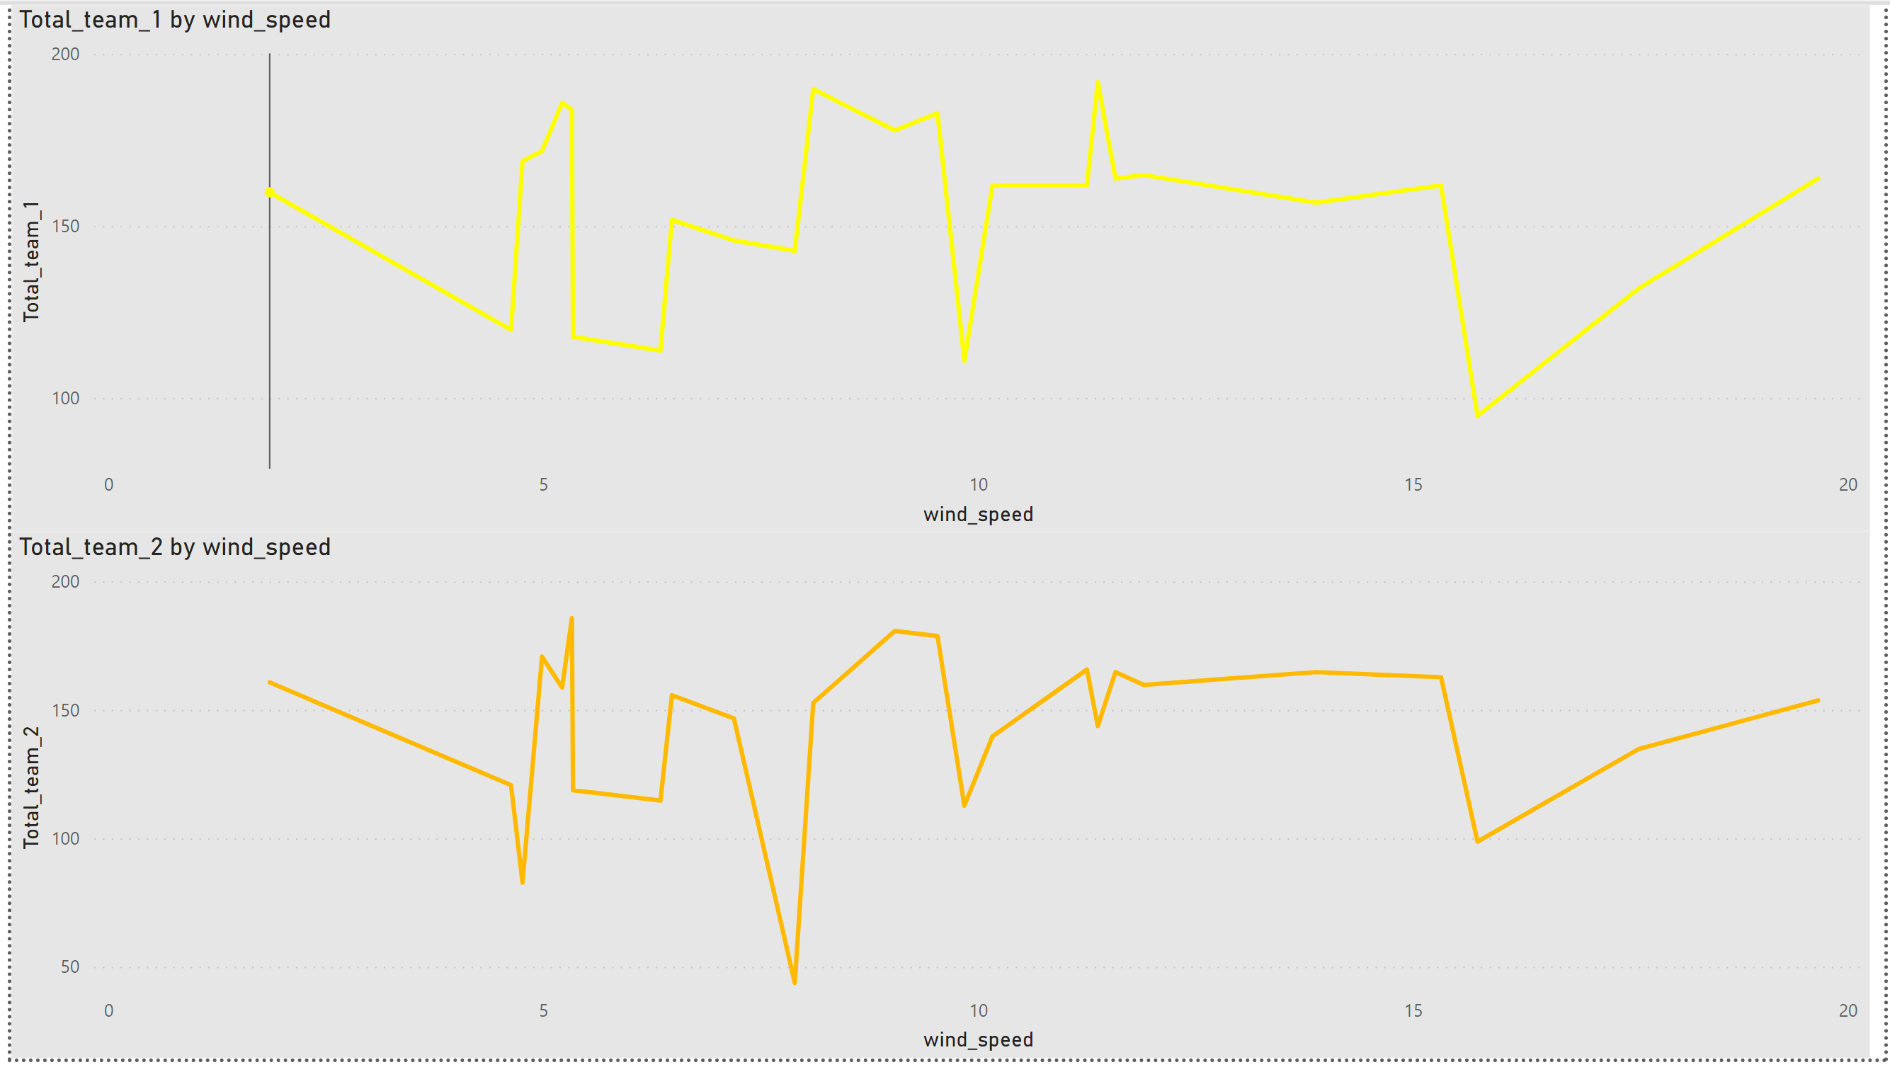
Analysis on Weather Dataset
Runs by each team VS Wind Speed

Slide 29
Thank You!
- Akshay Ankush Kapare

